Slide 1
How Jesus Instructs The Church
John 12:48
Ephesians 1:22-23

Slide 2
Jesus Sets Forth His Teaching

Slide 3
Jesus Sets Forth His Teaching
Matthew 16:13-20
Matthew 22:23-33
Sermon on the Mount
1 Peter 2:21

Slide 4
Apostles Used Same Method
Direct Statement
Approved Example
Necessary Inference
Acts 2:38
1 John 2:15
Galatians 5:24
Acts 20:7
Acts 11:26
Acts 10:28
Galatians 2:11-21

Slide 5
Method in Practice Acts 15
Direct Statement, vv. 16-17
Amos 9:11-12
Approved Example, v. 12
Paul & Barnabas worked miracles
Necessary Inference, vv. 7-10
Peter saw God pour the Spirit upon Gentiles
Conclusion? Jews & Gentiles saved by Gospel

Slide 6
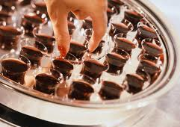
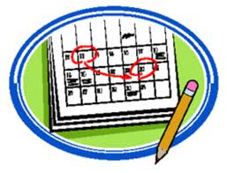
Lord’s Supper
“Do this in remembrance of Me”
1st Day of Week
Every 1st Day of Week
Direct
Command
Approved
Example
Necessary
inference

Slide 7
How Can The Following Be Authorized?
Sprinkling for Baptism
Instrumental Music in Worship
Roman Catholic Organization
Worship of Saints
Etc.

Slide 8
Conclusion
Colossians 3:17 – “And whatever you do in word or deed, do all in the name of the Lord Jesus, giving thanks to God the Father through Him.”
Matthew 7:21 – “Not everyone who says to Me, ‘Lord, Lord, shall enter the kingdom of heaven, but he who does the will of My Father in heaven.’”

