Slide 1
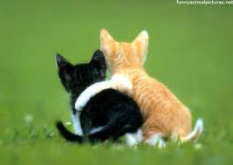
A Refreshing Friend
2 Timothy 1:16-18

Slide 2
2 Timothy 1:16-17
The Lord grant mercy to the household of Onesiphorus, for he often refreshed me, and was not ashamed of my chain; but when he arrived in Rome, he sought me out very zealously and found me.
Means
“profit-bearer”

Slide 3
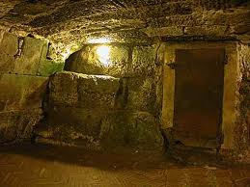
Why Does Paul Need Refreshing?
In prison, facing death, 2 Tim. 4:6
Winter was coming, 2 Tim. 4:21
Demas had forsaken him, 2 Tim. 4:10
At his first defense, all forsook him, 2 Tim. 4:16
As well as those of Asia, 2 Tim. 1:15

Slide 4
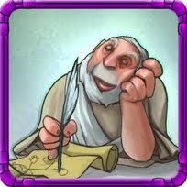
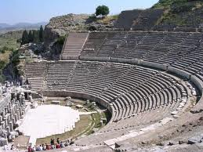
Onesiphorus
Typical, frequent service: “He often refreshed”
Also ministered to him in Ephesus, 2 Tim. 1:18

Slide 5
Onesiphorus
Imitated Jesus, Matt. 11:28
“…I will give you rest”
To refresh
To give new strength to, reinvigorate
Jesus is like rivers of water in a dry place, Jn. 4:10-14
Jesus is as light for those in darkness, Lk. 1:79
Jesus is cheer for the downhearted, Ps. 126:5

Slide 6
Refreshing: A Great Need
Choose as your life’s work one that is necessary to human well-being!
Choose with the idea of serving, Matt. 23:11
Paul served others, Acts 27:25
1 Thess. 5:11 “Therefore comfort each other and edify one another, just as you also are doing”

Slide 7
Onesiphorus How did he refresh Paul?
He went to see him
He sympathized with him
He refreshed by Paul by what he was

Slide 8
Conclusion
May God give you the heart, desire & thoughtfulness to be today’s Onesiphorus!
1 Cor. 16:17-18 “I am glad about the coming of Stephanas, Fortunatus, and Achaicus, for what was lacking on your part they supplied. For they refreshed my spirit and yours. Therefore acknowledge such men.”

