Slide 1
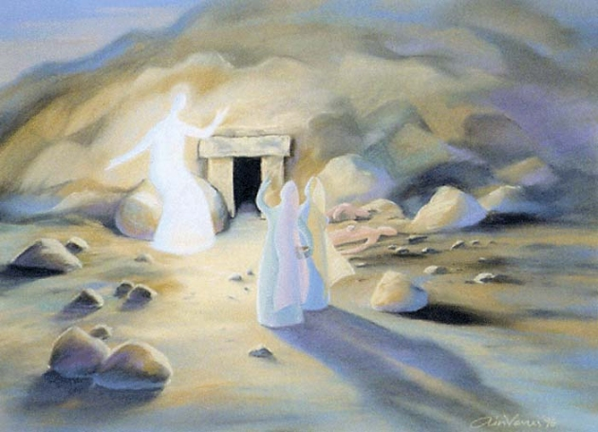
The Resurrection of Jesus
“Why do you seek the living among the dead?”
Luke 24:5
Notes:
Luke 24:5 - “Why do you seek the living One among the dead?”

Slide 2
Resurrection of Jesus
Defined
“By resurrection it is meant that the body of Jesus was changed from a dead to a living body. What was laid in the grave dead came forth from there alive.” E.Y. Mullins
Unique
“All but four of the major world religions are based on mere philosophical propositions. Of the four that are based on personalities rather than a philosophical system, only Christianity claims an empty tomb for its founder.” Josh McDowell

Slide 3
Resurrection of Jesus Importance
Two fundamental doctrines
Jesus is the Son of God
All mankind will be judged
Two different perspectives
One is looking at the past – Jesus
One is looking into the future – Judgment
One absolute proof
Romans 1:1-4
Acts 17:30-31

Slide 4
Resurrection of Jesus Importance
Proved Jesus was God’s Son
Jesus said this would happen
Matt. 16:21; 17:22-23; 20:18-19; John 2:18-22
Considerations
This was out of Jesus’ control. He was dead!
If God would not raise Him, then His claim was false. If false, what about His teaching?
But if God did raise Him, this gave powerful proof for His claim and His teaching!

Slide 5
Resurrection of Jesus Importance
Proved Jesus was God’s Son
Jesus said this would happen
Matt. 16:21; 17:22-23; 20:18-19; John 2:18-22
Considerations
Yes – His teaching was impressive
Matthew 7:28-29
Yes – His miracles caused belief
John 20:30-31
But His resurrection was the ultimate proof!

Slide 6
Resurrection of Jesus Importance
All mankind would be judged
Jesus said this would happen
John 5:28-29; Matthew 25:31-46
Considerations
Judgment comes after death – Heb. 9:27
Dead people can’t be judged so they must be raised from the dead.
God has proven His power to raise all men by raising Jesus from the dead.
Jesus is called the first fruits – 1 Cor. 15:20-27
If Jesus wasn’t raised, no proof I can be raised, no evidence that mankind will be judged.
Notes:
Matthew 25:31-46 – resurrection is implied – eternal life and condemnation are under consideration but these bodies are temporary.

Slide 7
Resurrection of Jesus Importance
If no resurrection then Christianity is worthless!
1 Corinthians 15:12-19
Preaching is worthless - vs. 14
Faith is worthless - vs. 14
Apostles are liars - vs. 15
Still in sin - vs. 17
Most pitiable - vs. 19

Slide 8
Was Jesus really resurrected from His grave?

Slide 9
Resurrection of Jesus Evidence
Two aspects to evidence
An empty tomb
By itself this would leave everything underneath a cloud of mystery. A resurrection would only be one among many possibilities and no more credible than the others.
Resurrection appearances
But with the appearances to many witnesses, now we have credible eye-witness testimony which provides powerful evidence for a resurrection.

Slide 10
Resurrection of Jesus Evidence
An empty tomb - Matt 28:1-8
“The resurrection . . . Could not have been maintained in Jerusalem for a single day, for a single hour, if the emptiness of the tomb had not been established as a fact for all concerned.”
Paul Althus

Slide 11
Resurrection of Jesus Evidence
An empty tomb - Matt 28:1-15
“In all the fragments and echoes of this far-off controversy which have come down to us we are no where told that any responsible person asserted that the body of Jesus was still in the tomb. We are only given reasons why it was not there. Running all through these ancient documents is the persistent assumption that the tomb of Christ was vacant.”
Frank Morison

Slide 12
Resurrection of Jesus Evidence
An empty tomb - Matt 28:1-15
“It should be noticed first of all that the Jewish authorities never questioned the report of the guards. They did not themselves go out to see if the tomb was empty, because they knew it was empty. The guards would never have come back with such a story as this on their lips, unless they were reporting actual, indisputable occurrences as far as they were able to apprehend them.”
Wilbur M. Smith

Slide 13
Resurrection of Jesus Evidence
An empty tomb - Matt 28:1-15
“. . . positive evidence from a hostile source, which is the strongest kind of historical evidence. In essence, this means that if a source admits a fact decidedly not in its favor, then that fact is genuine”
Paul L. Maier
“If the Christians and their Jewish opponents both agreed that the tomb was empty, we have little choice but to accept the empty tomb as an historical fact.”
Ron Sider

Slide 14
Resurrection of Jesus Evidence
Resurrection Appearances
1 Corinthians 15:3-8
Matthew 28:1, 9 - Mary Magdalene & Mary
Luke 24:13-31 - Two disciples traveling
John 20:19-20 - Twice to apostles
John 21:1-13 - Seven disciples fishing

Slide 15
Resurrection of Jesus Evidence
Circumstantial Evidence
Apostles change in behavior
Unbelievers - Luke 24:11, 19-24
Cowards - John 20:19
Believers - Acts 2:14; Mark 16:20
Explanation - Mark 16:14; 1 Cor. 15:5

Slide 16
Resurrection of Jesus Evidence
Circumstantial Evidence
Apostle Paul
Persecutor - Acts 8:1-3; 9:1-2
Preacher - Acts 9:20-22
Explanation - Acts 9:3-19

Slide 17
Resurrection of Jesus Evidence
Summary
An Empty Tomb
Resurrection Appearances
Circumstantial Evidence

Slide 18
The Resurrection of Jesus
“Why do you seek the living among the dead?”
Luke 24:5
Notes:
Luke 24:5 - “Why do you seek the living One among the dead?”

Slide 19
Resurrection of Jesus Explanations
The empty tomb
Theft?
Wrong Tomb?
Swoon?
The resurrection appearances
Hallucination?
Lied?
The whole story is myth?

Slide 20
Resurrection of Jesus Explanations
Theft?
Matthew 28:11-15
Problems
Every soldier slept?
Testified though asleep?
Disposition of disciples
Rulers didn’t believe explanation
Grave clothes left behind?
Notes:
Disposition of disciples
Matthew 26:56; Mark 14:50 – all fled when Jesus was arrested, except for John (John 18:15-16) and Peter following from a distance (Luke 22:54).
Grave clothes left behind
John 19:40 – body of Jesus was bound in linen wrappings
John 20:6-7 – Why would thieves take time to unwrap body of Jesus and leave the linen wrappings behind?

Slide 21
Resurrection of Jesus Explanations
Wrong tomb?
Problems
All went to wrong tomb?
Women, Peter & John, Angel?
Women paid close attention
Matthew 27:61; Mark 15:47; Luke 23:55
If all went to wrong tomb?
Joseph or Sanhedrin produce right tomb.
Private garden
Not likely to be mistaken

Slide 22
Resurrection of Jesus Explanations
Swoon?
Last hours of Jesus’ life
Fervent prayer in Gethsemane Luke 22:39-46
Betrayed by a friend Matthew 26:47-50
Rest of followers deserted him Mark 14:50
Illegal trials Mark 14:55-59
Mistreated at trial Matthew 26:67-68
Beaten by guards Mark 14:65
Scourged by Romans Matthew 27:26
Robe and crown of thorns Matthew 27:27-31
Carried cross & crucified John 19:17
Side pierced by spear John 19:31-37

Slide 23
Resurrection of Jesus Explanations
Swoon?
Burial procedures
Preparation of the body John 19:38-40
Tomb of Joseph of Arimathea Matt. 27:59-60
Stone which sealed the tomb Matthew 27:60
Security precautions
Guarded by Roman soldiers Matt. 27:62-65

Slide 24
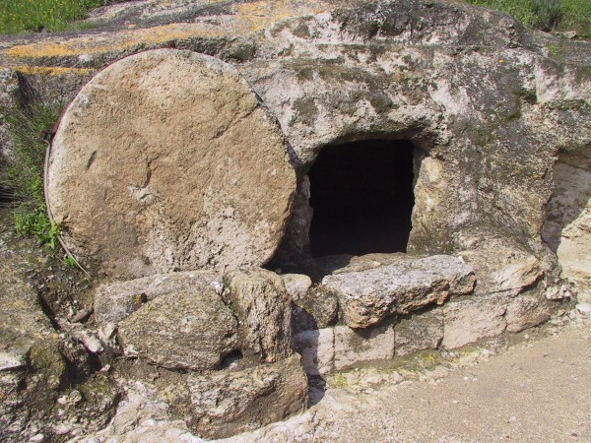

Slide 25
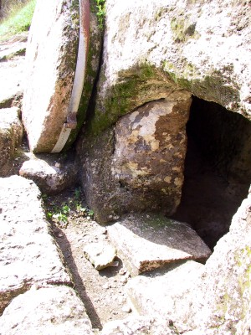

Slide 26
Resurrection of Jesus Explanations
Swoon?
Problems
Centurion, Joseph, Nicodemus mistaken
Survived w/out medical attention?
Able to remove grave clothes?
Able to move large stone?
Able to walk to Emmaus? Jerusalem?
Jesus lied and deceived?
Mysteriously disappeared?

Slide 27
Resurrection of Jesus Explanations
Hallucination?
Problems
Most people high strung, imaginative
Come from sub-conscious thus very individualistic and subjective.
At familiar place in reminiscing mood.
Anticipating something to happen.
Tend to recur or grow fewer till no more.

Slide 28
Resurrection of Jesus Explanations
Lied?
Problems
There was nothing for them to gain
2 Corinthians 11:23-27
Why would you suffer for a lie?
Acts 4:21; 5:19, 29-33, 40-41
Why would you die for a lie?
Acts 12:2;
2 Peter 1:14 (John 21:18-19)
2 Timothy 4:6-8

Slide 29
Resurrection of Jesus Explanations
Myth?
Problems
Takes a number of years to develop.
Many hostile witnesses.
Gospels don’t resemble Greek myth or Jewish legend.
Jews opposed myths confusing deity with humanity.
Notes:
Takes a number of years to develop
“There are no parallels in other literature of myth developing and being believed in the presence of eye-witnesses and within the short timeframe in which the New Testament was formed.” Christiananswers.net
John Macquarrie writes, "Myth is usually characterized by a remoteness in time and space… as having taken place long ago." By contrast the Gospels concern "an event that had a particularly definite location in Palestine… under Pontius Pilate, only a generation or so before the New Testament account of these happenings." [John Macquarrie, God-Talk: An Examination of the Language and Logic of Theology (Harper, 1967), pp. 177-180.]
Paul’s first letters are within 25 years of Jesus’ resurrection while the gospels are within 21 years.
This explain why many scholars attempt to give much later dates to many NT books, they need the time and space to propagate their myth theory.
Many hostile witnesses
“These opponents had both motives and means to correct falsehoods about Him had the first disciples attempted them. Yet their opportunity did not produce a serious correction.” Christiananswers.net

Slide 30
Resurrection of Jesus Conclusion
“The simple faith of the Christian who believes in the Resurrection is nothing compared to the credulity of the skeptic who will accept the wildest and most improbable romances rather than admit the plain witness of historical certainties. The difficulties of belief may be great; the absurdities of unbelief are greater.”
George Hanson

Slide 31
The Resurrection of Jesus
“Why do you seek the living among the dead?”
Luke 24:5
Notes:
Luke 24:5 - “Why do you seek the living One among the dead?”

