Slide 2
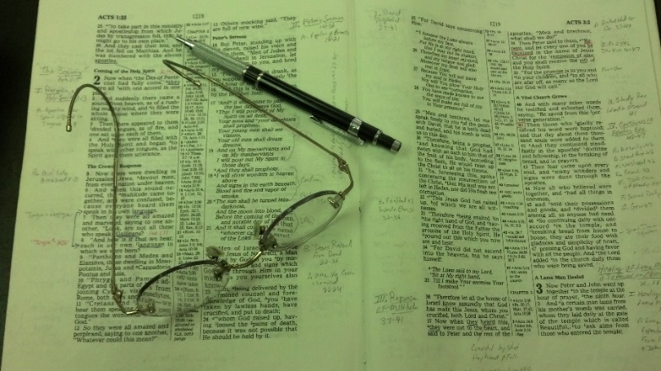
Topics
Thursday: The Seduction of Joseph
Friday: The Wayward Son Comes Home
Day Classes
Friday: Forgiveness (Matt. 18:21-35)

Slide 3
Deut. 6:1-3
1 "Now this is the commandment, and these are the statutes and judgments which the LORD your God has commanded to teach you, that you may observe them in the land which you are crossing over to possess,
2 that you may fear the LORD your God, to keep all His statutes and His commandments which I command you, you and your son and your grandson, all the days of your life, and that your days may be prolonged.
3 Therefore hear, O Israel, and be careful to observe it, that it may be well with you, and that you may multiply greatly as the LORD God of your fathers has promised you--'a land flowing with milk and honey.'

Slide 4
Deut. 6:1-3
1 "Now this is the commandment, and these are the statutes and judgments which the LORD your God has commanded to teach you, that you may observe them in the land which you are crossing over to possess,
2 that you may fear the LORD your God, to keep all His statutes and His commandments which I command you, you and your son and your grandson, all the days of your life, and that your days may be prolonged.
3 Therefore hear, O Israel, and be careful to observe it, that it may be well with you, and that you may multiply greatly as the LORD God of your fathers has promised you--'a land flowing with milk and honey.'
Introduction to rest of chapter
God given his word – taught
  “Commandment” – told do to
  “Statutes” - regulations
  “Judgments” – verdict pronounced
That:
  May observe them (v. 1)
  May fear God (v. 2)
  May enjoy long life (v. 2)
  May be well with you (v. 3)
  May multiply greatly (v. 3)

Slide 5
When We Heed The Word, All Goes Well!
When We Heed The Word, All Goes Well!
3 Therefore hear, O Israel, and be careful to observe it, that it may be well with you, and that you may multiply greatly as the LORD God of your fathers has promised you--'a land flowing with milk and honey.'
“..so that all will go well..” (Living Bible)
“…then all will go well for you..” (New Century Version)

Slide 6
Life Going Well
All of us want a life – that is going well
What follows: (vv. 4-ff) is called “Shema” (Hear)

Slide 7
Life Going Well
Solemn Declaration (v. 4)

Slide 8
Solemn Declaration (v. 4)
True religion begins with recognition that the Lord is one
Emphasis: unity of deity – contrast to pagan pantheons
  Egypt (from whence came) – had 2000+ gods
  Canaan (where headed) – had as many pagan gods
No room for compromise
  Jesus is the way (John 14:6)
  No other name (Acts 4:12)
  Have one source of instruction, law, authority

Slide 9
Life Going Well
Solemn Declaration (v. 4)
An Absorbing Attitude (v. 5)

Slide 10
An Absorbing Attitude (v. 5)
If Lord absorbs the affections, no room left for self / world
Love undivided – with “all” = total person
  Heart – intellectual, emotional, & conative faculties
  Soul – life, personality & self consciousness
  Might – Sum of his energies (physical & mental)
Sum of the commandments
  Matt. 22:37
  Mk 12: 33
  Luke 10:27

Slide 11
An Absorbing Attitude (v. 5)
If Lord absorbs the affections, no room left for self / world
Love undivided – with “all” = total person
  Heart – intellectual, emotional, & conative faculties
  Soul – life, personality & self consciousness
  Might – Sum of his energies (physical & mental)
Sum of the commandments
We suppose that can hold back part of it
  “Share its favors as we would share the contents of a box of candy” (Donald Ackland)
  Love that tries to divide self between God & self - not love at all!

Slide 12
Life Going Well
Solemn Declaration (v. 4)
An Absorbing Attitude (v. 5)
A Gracious Responsibility (vv. 6-9)

Slide 13
A Gracious Responsibility (vv. 6-9)
When the Lord is loved – He will be treasured, thought of, talked of, taught about & lived!
Word should be enshrined in your heart (v. 6)
  More than learning or knowing by heart
  Full consent of mind & complete implementation of will
  Religious profession is meaningless unless it translated into practice!
  Group activities - are no substitute for individual fellowship

Slide 14
A Gracious Responsibility (vv. 6-9)
When the Lord is loved – He will be treasured, thought of, talked of, taught about & lived!
Word should be enshrined in your heart (v. 6)
Word should be taught to your children (v. 7)
  Public reading & public instruction – not enough
  Diligently – Work with great effort
  “Impress them on your children” (NIV)
  Same word translated:
    “Whet” – Deut. 32:41
    “Sharp” – Psa. 45:5; 120:4; Isa. 5:28
  Point: “send them into them like a sharp weapon”

Slide 15
A Gracious Responsibility (vv. 6-9)
When the Lord is loved – He will be treasured, thought of, talked of, taught about & lived!
Word should be enshrined in your heart (v. 6)
Word should be taught to your children (v. 7)
Word should be talked about in your house (vv. 8-9)
  Jews took this literally
    Wore on person (Phylacteries)
    Cylinders on door post (Mezuzahs)
Notes:
[muh-zooz-uh

Slide 16
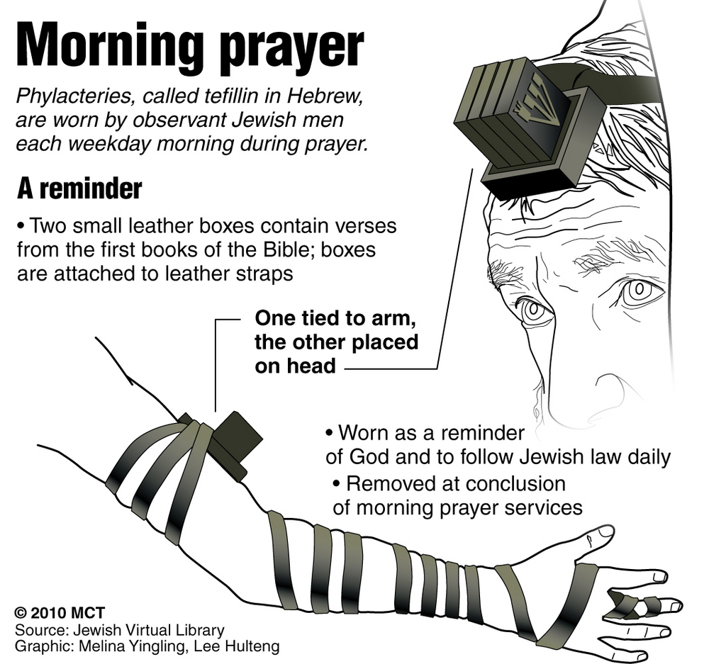
Phylacteries

Slide 17


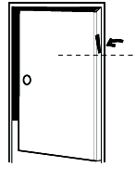
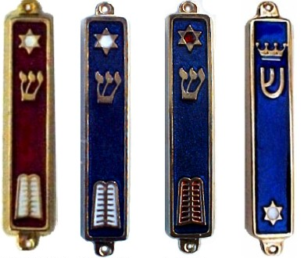
Mezuzah

Slide 18
A Gracious Responsibility (vv. 6-9)
When the Lord is loved – He will be treasured, thought of, talked of, taught about & lived!
Word should be enshrined in your heart (v. 6)
Word should be taught to your children (v. 7)
Word should be talked about in your house (vv. 8-9)
  Jews took this literally
    Wore on person (Phylacteries)
    Cylinders on door post (Mezuzahs)
  Point: ever keep it before us
    Hand – organ of action
    Eyes – organ of direction

Slide 19
Life Going Well
Solemn Declaration (v. 4)
An Absorbing Attitude (v. 5)
A Gracious Responsibility (vv. 6-9)
An Unmerited Possession (vv. 10-11)

Slide 20
An Unmerited Possession (vv. 10-11)
Abundantly blessed
  Israel – given a land, houses, wells, possessions, etc.
  We –
    Physical – material (Matt. 6:33)
    Spiritual (Eph. 1:3)
All is given by God – not of own making
  Every gift comes from above (Jas. 1:17)
  Every spiritual blessing (Eph. 1:3)
  Grace (Titus 3:3-5)
When realize how blessed we really are – will see that life is going quite well!

Slide 21
Life Going Well
Solemn Declaration (v. 4)
An Absorbing Attitude (v. 5)
A Gracious Responsibility (vv. 6-9)
An Unmerited Possession (vv. 10-11)
A Needful Reminder (v. 12)

Slide 22
A Needful Reminder (v. 12)
Danger – Tendency to forget God
  Forget – not don’t remember God – or never think about God
  Forget = not priority
  No longer love with ALL our heart (v. 5)
Prosperity can be a threat to a steadfast faith
  Prov. 30:7-9 – A danger just as poverty
  Become so engrossed in material world around us…spiritual matters play second fiddle
  “Material success could provide the seducing influence to wean them from God” (Donald Ackland)

Slide 23
Life Going Well
Solemn Declaration (v. 4)
An Absorbing Attitude (v. 5)
A Gracious Responsibility (vv. 6-9)
An Unmerited Possession (vv. 10-11)
A Needful Reminder (v. 12)
A Conditional Promise (v. 18)

Slide 24
A Conditional Promise (v. 18)
Promise was two fold:
  Go in to possess land
  Be well with you in the land
  Promises today:
    Eternal life (1 John 2:25)
    Hear & answer prayers (1 John 3:22)
Conditional – Do good & right in sight of God

Slide 25
Life Going Well
Solemn Declaration (v. 4)
An Absorbing Attitude (v. 5)
A Gracious Responsibility (vv. 6-9)
An Unmerited Possession (vv. 10-11)
A Needful Reminder (v. 12)
A Conditional Promise (v. 18)
An Expected Testimony (vv. 21-25)

Slide 26
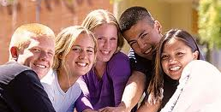
An Expected Testimony (vv. 21-25)
A remembrance of their past condition (v. 21)
An acknowledgement of the Lord’s righteous judgment against sin (v. 22)
A declaration of his power to save (v. 23)
An assurance of his faithfulness to his word (v. 23)
A warning against departure (v. 24)
An encouragement to careful obedience (v. 25)
Teach that to your children
Life is going well!

Slide 27
Life Going Well
Solemn Declaration (v. 4)
An Absorbing Attitude (v. 5)
A Gracious Responsibility (vv. 6-9)
An Unmerited Possession (vv. 10-11)
A Needful Reminder (v. 12)
A Conditional Promise (v. 18)
An Expected Testimony (vv. 21-25)

