Slide 2
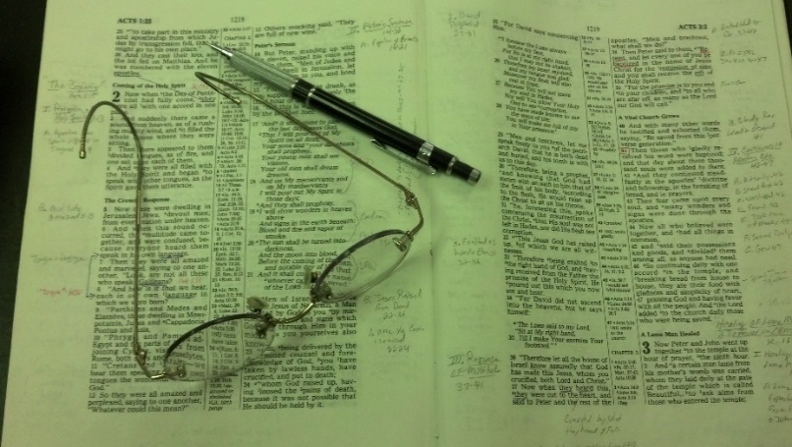
Topics
Monday: Is One Faith as Good as Another?
Tuesday: The Blame Game (Victim Mentality)
Wednesday: Life Going Well (Deut. 6)
Thursday: The Seduction of Joseph
Friday: The Wayward Son Comes Home
Day Classes
Monday: Who is the Greatest? (Matt. 18:1-9)
Wednesday: When You’ve Been Wronged (Matt. 18:10-20)
Friday: Forgiveness (Matt. 18:21-35)

Slide 3

Sexually Attractive
Dress
Carefully worded title – to describe the problem
Perhaps “immodesty” sends different message to different people
Thus, one whose dress is “sexually attractive” (whether know it or not) thinks she is not immodest!

Slide 4
Possible to dress so as to be “sexually attractive”
Prov 7:10
“And there a woman met him,
With the attire of a harlot, and a crafty heart.”
“…dressed seductively” (LBP)
Being sexually attractive / attracted is not wrong
  Prov. 5:15-19
  1 Cor. 7:9
  In fact, God made us that way!
Being sexually attractive / attracted to anyone other than marriage partner – IS WRONG!

Slide 5
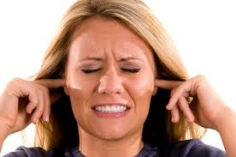
Ask That Give This Study Fair Hearing
Such studies do more good that credit them.
  Be worse if didn’t preach….
  Is MUCH worse in many churches
Not all will accept – 100%
Not all who accept it 100% will conform to principles
Ask: give this a fair & honest hearing
Going to speak plainly & bluntly!

Slide 6
Beginning Considerations
Bible Sets
Guidelines
About Dress
Thus Violation = Sin
Bible = Standard
World
Parents
Preacher
Elders
Always Thought / Done
You Want
To Dress
In Harmony
With The Bible
If so – will listen
& appreciate
(Jas. 1:21-22)
If not – rejected
God himself
(Jno. 12:48)
X
X
X
X
X

Slide 7
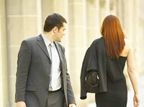
Must Admit: Great Portion of Today’s Clothing is Sexually Attractive
Low Cut Tops
Tight Jeans
Short Skirts
Form Fitting
Short Shorts
Splits in Dress
Wording on Rear
Draws Attention to Female Body
Mary Quant (designer of mini-skirt): “Mini-clothes are symbolic of those women who want to seduce a man” When asked where this is all headed, she said, “Sex”
Life Magazine reported that short shorts were favored to Bermuda shorts because Bermuda shorts emphasized the least attractive part of the legs – the knee and calf. (Sept. 10, 1956)

Slide 8

Must Admit: Great Portion of Today’s Clothing is Sexually Attractive
Low Cut Tops
Tight Jeans
Short Skirts
Form Fitting
Short Shorts
Splits in Dress
Wording on Rear
Draws Attention to Female Body
Culture Thinks
It Is Good
Isa. 5:20
Phil. 3:19
Naïve to Think
Our Culture
Does Not Rub
Off on Us!

Slide 9
Reasons
People Dress Sexually Attractive
Ignorant & Untaught
Want to fit in
Want to be bold and “turn heads”
Careless – Don’t stop & think
  About Divine principles
  Allow world’s standards to influence them
  Brethren gradually get looser
Don’t know how they really look

Slide 10
Reasons
People Dress Sexually Attractive
Ignorant & Untaught
Want to fit in
Want to be bold and “turn heads”
Careless – Don’t stop & think
  About Divine principles
  Allow world’s standards to influence them
  Brethren gradually get looser
Don’t know how they really look

Slide 11


Sexually Attractive Dress
Simple Principles For Dress

Slide 12
Simple Principles For Dress
Divinely Made Clothing

Slide 13


Divinely Made
Clothing
Genesis 3
Apron
V. 7
“Naked”
(Nude)
V. 10
“Naked”
(Relatively)

Slide 14
Apron
Made for themselves
Girdle-like
Loin Cloth type of garments
V. 10
“Naked”
(Relatively)
William Gesenius, Hebrew-Chaldee Lexicon of the Old Testament, 260
H.C. Leupold, Exposition of Genesis, I: 154-155
C.F. Keil and F. Delitzsch, The Pulpit Commentary, I: 59
Brown, Driver & Briggs Hebrew Lexicon

Slide 15
Divinely Made
Clothing
Genesis 3
Apron
Tunic
From The
Shoulder
To The
Knee
V. 7
“Naked”
(Nude)
V. 10
“Naked”
(Relatively)
V. 21
Clothed
Nakedness Covered

Slide 16
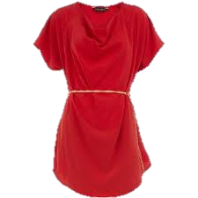
Original I.S.B.E. article on “Dress” says chiton “resembled the Roman tunic, corresponding most nearly to our long shirt, reaching below the knee always, and, in case it was designed for dress occasions, reaching almost to the ground” (I.S.B.E., II:877). Later in the article, it is noted that the chiton of the peasantry was shorter like modern kamis of Syrian fellah which is to the knee.

Slide 17
Hebrew: KUTTONET--"a tunic...; generally with sleeves, coming down to the knees, rarely to the ankles" (Gesenius, 420; cf. Harris, 1:459; Brown, Driver, Briggs, 509).

Slide 18
Wright says, “The tunic (inappropriately translated ‘coat’) was a shirt which was worn next to the skin. It was made of leather, hair-cloth, wool, linen, or in modern times, usually of cotton. The simplest form of it was without sleeves and reached to the knees or sometimes to the ankles. The well-to-do wore it with sleeves and extending to the ankles. Women as well as men wore it [see Cant. 5:3, A.R.V.], although there was no doubt a difference in style and pattern in what was worn by the two” (Fred H. Wight, Manners and Customs of Bible Lands, 91).

Slide 19
Divinely Made
Clothing
Genesis 3
Apron
Tunic
From The
Shoulder
To The
Knee
V. 7
“Naked”
(Nude)
V. 10
“Naked”
(Relatively)
V. 21
Clothed
Nakedness Covered

Slide 20
Simple Principles For Dress
Divinely Made Clothing
Nakedness is Not to be Seen (Except by Mate)
  In OT uncovering “the nakedness” of anyone other than mate – prohibited (Lev. 18:6-7)
  Implies that NORMAL STATE OF THINGS IS FOR NAKEDNESS TO BE COVERED!
  Showing nakedness – equated with shame
    Gen. 3:7
    Rev. 3:17; 16:15; 17:16

Slide 21
Nakedness
Complete Nudity
Partial Nudity
“Unclad, without clothing” (Thayer, p. 122)
“Ill-clad” or “clad in undergarment only” (Thayer, p. 122)
“badly clad” or “not fully clothed” (Kittle, I:773-774)
“lightly clad” (Liddell & Scott, 170)
Point: One can have some clothing on
and still be “naked”

Slide 22
Nakedness
Exposing the thigh = exposing one’s Nakedness
Gen. 3:7, 10-11
Exo. 28:42
Isa. 47:2-3
}
Nakedness

Slide 23

When One Sees Your Thigh
He Sees Your Nakedness
Bathing suit
Shorts
Short Dress
Rides up above knees
Splits that give a peek
Holes in jeans

Slide 24
Simple Principles For Dress
Divinely Made Clothing
Nakedness is Not to be Seen (Except by Mate)
Men are More Visually Stimulated Than Women
  Compared to women, men are more aroused by VISUAL stimuli
    Why porn is more of temptation for men
    Easily look and lust (Matt. 5:28)
    Her beauty can be a temptation (Prov. 6:25)
    Far more quickly (“Crockpot –vs-microwave”)

Slide 25
Simple Principles For Dress
Divinely Made Clothing
Nakedness is Not to be Seen (Except by Mate)
Men are More Visually Stimulated Than Women
  Compared to women, men are more aroused by VISUAL stimuli
  Ladies – it doesn’t take much – visually – to arouse a man’s sexual interest in you (Even a hint, glimpse, or a peek)
  True – are men with dirty minds (2 Pet. 2:14)
    Not the man we are concerned about
    Not all men have dirty minds – yet are tempted!
  Are good, godly men who try best be pure – who when they see sexually attractive dress – have to fight sexual thoughts!

Slide 26
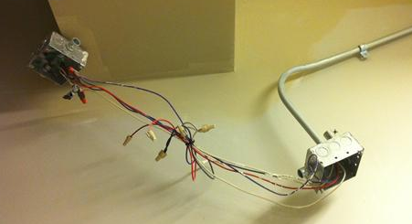
For a woman to dress in a way that is sexually attractive – Then put all the blame on man for his thoughts….
Like leaving bare wires exposed – Then blame the child who gets shocked!

Slide 27
Simple Principles For Dress
Divinely Made Clothing
Nakedness is Not to be Seen (Except by Mate)
Men are More Visually Stimulated Than Women
Modest
1 Timothy 2:9-10
9 In like manner also, that women adorn themselves in modest apparel, with shamefacedness and sobriety; not with broided hair, or gold, or pearls, or costly array;
10 But (which becometh women professing godliness) with good works.
KJV

Slide 28

Modest
1. Having or showing a moderate estimation of one’s own talents, abilities, and value. 2. Having a shy or retiring nature; reserved. 3. Observing conventional proprieties in speech, behavior, or dress. 4. Quiet and humble in appearance; unpretentious: a modest house 5. Moderate; not extreme: a modest charge.” (American Heritage Dictionary, p. 806).

Slide 29
Modest
W. E. Vine: “orderly, well-arranged, decent, ... The well-ordering is not of dress and demeanor only, but of the inner life, uttering indeed and expressing itself in the outward conversation.” (Vol. III, p. 79).

Slide 30
Modest
Strongs: “orderly, i.e. decorous: - of good behavior” (#2887). From kosmos (#2889) which means orderly or well arranged. Word for world.
Thayer: “well-arranged, seemly, modest” (p. 356).
Bauer: “respectable, honorable” (p. 445).
Kubo: “modest, respectable” (p. 205).

Slide 31
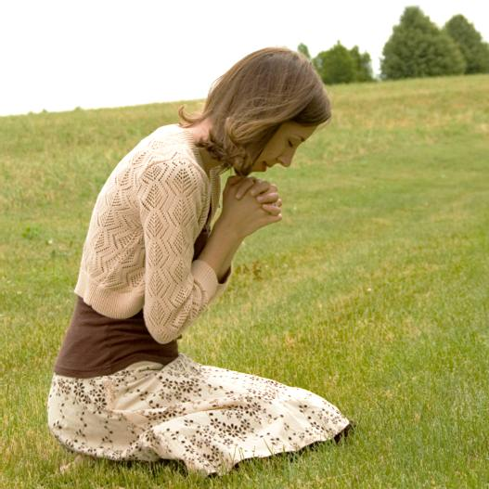
Modest Summarized
Reserved
Humble
Respectable
Decent
Orderly

Slide 32
Simple Principles For Dress
Divinely Made Clothing
Nakedness is Not to be Seen (Except by Mate)
Men are More Visually Stimulated Than Women
Modest
Shame
1 Timothy 2:9-10
9 In like manner also, that women adorn themselves in modest apparel, with shamefacedness and sobriety; not with broided hair, or gold, or pearls, or costly array;
10 But (which becometh women professing godliness) with good works. KJV

Slide 33
Shame
KJV uses word “shamefacedness”; ASV - “shamefastness”; NKJV uses the word “ propriety”.
From AIDOS which means:
  “A sense of shame, modesty, … ‘Shamefastness is that modesty which is ‘fast’ or rooted in the character...’” (Vines, Vol. IV, p. 17)
  Strong suggests that it may be from two words which would give the idea of “downcast eyes” thus meaning “bashfulness” (#127).

Slide 34
Simple Principles For Dress
Divinely Made Clothing
Nakedness is Not to be Seen (Except by Mate)
Men are More Visually Stimulated Than Women
Modest
Shame
Good Judgment
1 Timothy 2:9-10
9 In like manner also, that women adorn themselves in modest apparel, with shamefacedness and sobriety; not with broided hair, or gold, or pearls, or costly array;
10 But (which becometh women professing godliness) with good works. KJV

Slide 35
Good Judgment
KJV uses the word “sobriety”; NKJV - “moderation”.
From SOPHROSUNE which means:
  “Soundness of mind... ‘sound judgment’ practically expresses the meaning; ‘it is that habitual inner self- government, with its constant rein on all the passions and desires which would hinder the temptation to these from arising....” (Vines, Vol. IV, pp. 44-45).
  “Soundness of mind, i.e.(lit,) sanity or (fig.) self- control” (Strongs, # 4997).
  Good judgment says: Don’t show what he shouldn’t see!

Slide 36
Ways
That
One
Can
Be
Immodest
Too Short
Too Tight

Slide 37
Costly Clothing / Fine Apparel
1 Tim 2:9-10
9 in like manner also, that the women adorn themselves in modest apparel, with propriety and moderation, not with braided hair or gold or pearls or costly clothing,
“I see clothes of silk, if clothes they can be called, affording protection neither to the body not to the modesty of the wearer, and which are purchased for enormous sums, from unknown people”
(Seneca - 4BC – 64AD)
1 Peter 3:3
3 Do not let your adornment be merely outward--arranging the hair, wearing gold, or putting on fine apparel--

Slide 38
Costly Clothing / Fine Apparel
1 Tim 2:9-10
9 in like manner also, that the women adorn themselves in modest apparel, with propriety and moderation, not with braided hair or gold or pearls or costly clothing,
“For luxurious clothing, which cannot conceal the shape of the body, takes its form more easily, and adhering as it were to the flesh, receives its shape, and marks our the woman’s figure, so that the whole body is visible.”
(Clement of Alexandria)
1 Peter 3:3
3 Do not let your adornment be merely outward--arranging the hair, wearing gold, or putting on fine apparel--

Slide 39
Ways
That
One
Can
Be
Immodest
Too Short
Too Tight
Too Thin
Too Low
Too Loose

Slide 40

Sports
Modesty / “Sexually Attractive” Applies:
Weddings
Yard Work

Slide 41
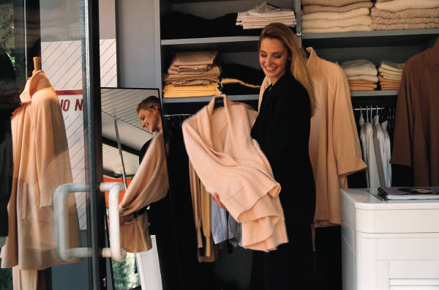
Modest
Shame
Good Judgment
Godliness
Careful toward Others
Immodest
No Shame
Poor Judgment
Don’t Fear God
May Cause Lust
Swimsuits
Cheerleading Outfits
Short Dresses
Split Dresses
Tight / Formfitting
Sun Dresses
Low-Cut Blouses & Dresses
Shorts (reveal the thigh)
Jogging Shorts
Leggings / Tights
Strapless Dresses
Swimming Trucks
See-Through Styles
Majorette Uniforms

Slide 42

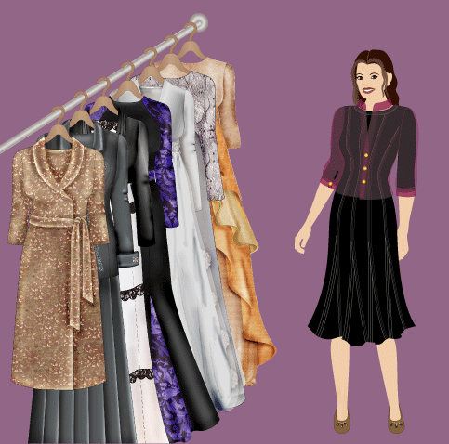
Application
{
Not A Lot
of Problem:
Short Dresses
Shorts
Men w/o shirts
Bathing suits
Tight (show body form)
Low cut (in back)
Low cut (shows cleavage)
See-Through (see under..)
Loose (see cleavage)
Sun Dress (same as low cut)
Midriff shows

Slide 43
Sexually Attractive Dress
Simple Principles For Dress
Possible Your Clothes Could Be Sexually Attractive

Slide 44
Possible Your Clothes Could Be Sexually Attractive
Clarify “Sexually Attractive”
  “Attract”
    From Latin ad (“in the direction of”) + trahere (“to pull”)
    Attract = draw or pull toward
    Related words: tractor, traction
  “Attractive”
    Providing pleasure, arouse interest
    Having ability to draw or pull
  “Sexually Attractive Clothing” – draws or pulls attention toward one’s body
    SEXUAL ATTENTION!
    Draws attention to sections of body that are sexually arousing

Slide 45
Possible Your Clothes Could Be Sexually Attractive
Clarify “Sexually Attractive”
Our Clothing Sends a Signal – At Times Sexual
  Whether we realize it or not
  Whether we intend it or not
  As far as men are concerned: sexually attractive clothing has the same effect whether that is your intent or not!
  May be sending signals – not aware you are sending!

Slide 46
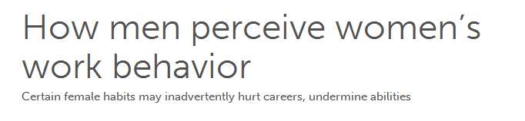


“And among the thousands of men and women I have interviewed and surveyed over the years, I have found no subject more universally misunderstood than what a man thinks when he sees a women overtly showing a good figure.”
Excerpted from “The Male Factor: The Unwritten Rules, Misperceptions, and Secret Beliefs of Men in the Workplace” by Shaunti Feldhahn Copyright © 2009 by Veritas Enterprises.
Notes:
http://today.msnbc.msn.com/id/34861316/ns/today-books/t/how-men-perceive-womens-work-behavior/#

Slide 47
“We are frequently told “men are visual” — but I’ve realized that many women don’t know what that actually means. According to brain scientists and researchers such as Michael Gurian, some percent of women — perhaps as high as 25 percent — are visual in a similar way to men. If you’re in that category you are more likely to instinctively understand men’s reactions. But the other 75 percent of women who aren’t that “visual” have very little concept, literally, of how men see them.”
Notes:
http://today.msnbc.msn.com/id/34861316/ns/today-books/t/how-men-perceive-womens-work-behavior/#

Slide 48
“And yet, in most instances, the woman has no idea what is really going on inside the minds of the men around her.”
“The visual wiring men have presents a similar temptation that men say they often don’t want and wish they could turn off — especially in a business setting. Their visual nature is highly attuned to and predisposed to take in appealing images, including images of an appealing woman. And if that woman is dressing in a way that emphasizes her assets, that fact is not only noticed but often begins a train of thought that more men in business would rather not have.
But their visual nature isn’t something that can be turned off. They must work to ignore it.
In talking to men, I found most were incredibly puzzled as to why the woman wouldn’t want to avoid the situation. Why, the men wonder, is a professional woman dressing in a way that is likely to cause men to be distracted and miss some of what she’s saying? And the answer, of course, is that most women have no intention of causing that sort of distraction, and don’t realize that they are doing so.”

Slide 49
“The male-female disconnect
To test the difference in men’s and women’s perceptions in this area, I asked men what they would think if they saw a woman dressing in a way that emphasized or showed off her figure in some way, such as a low-cut top or a tight skirt. Then I asked white collar women who said they sometimes dressed in that way what was actually going through their minds. Here are the starkly differing results. Seventy-six percent of the men felt the woman wanted the men around her to look at her body. Yet only twenty-three percent of the women actually felt that way. In other words, three out of four women said that was not what they were thinking at all!”

Slide 50
Possible Your Clothes Could Be Sexually Attractive
Clarify “Sexually Attractive”
Our Clothing Sends a Signal – At Times Sexual
Testimony From a Prostitute
  Attire of a harlot (Prov. 7:10) – says a lot
    Says she knows how to be sexually attractive
    Not a “trashy, painted up gal, who walks streets”
    Clothing that draws or pulls sexual attention
  Years Ago – Gary Henry interviewed a prostitute
    She rode beside him on a bus trip
    She was working weekends at a brothel on commission
    Asked her to define the “attire of a harlot”

Slide 51
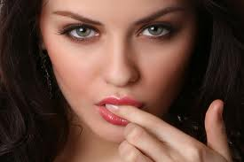
Interview With
A Prostitute
How to draw attention to certain parts of your body:
Reveal it (Least effective)
Conceal it and reveal everything else (Bikini)
Reveal just a little of it (hint, preview, glimpse)
Cover it tightly (show form)
Cover it thinly (Most provocative)

Slide 52
Interview With
A Prostitute
Gary: “You know a good bit about men”
Prostitute: “Its my business to know ..”
Gary: Why religious women often don’t know as much about men
Prostitute: Because they have never been taught about men by anyone but their mothers (who often knew very little themselves). Women who know how a man thinks are those who have been taught by a man!

Slide 53
Interview With
A Prostitute
How to draw attention to certain parts of your body:
Show more “skin”
More shown – more attractive
Give them a look at your thighs
Give them a look at breasts (just part)
Let them see your midriff
Show them your back / shoulders
Reveal it

Slide 54
Interview With
A Prostitute
How to draw attention to certain parts of your body:
Conceal it and reveal everything else
Swimsuits – especially Bikini
Draws attention to what remains covered

Slide 55
Interview With
A Prostitute
How to draw attention to certain parts of your body:
Give a glimpse of the thigh
Dress / skirt not real short (get a hint)
Jeans that play peek-a-boo with low back
Cleavage – gives a preview of breast
Reveal just a little bit of it

Slide 56
Interview With
A Prostitute
How to draw attention to certain parts of your body:
One piece swimsuits
Tight jeans / pants
Tops that reveal shape of breast
Snug fit (dress / skirt) over back side
Lines of undergarment clearly marked
Cover it tightly

Slide 57
Interview With
A Prostitute
How to draw attention to certain parts of your body:
White / thin tops – reveal undergarment
Thin pants – outline underwear
Material so thin – clings to body
Cover it thinly

Slide 58
Possible Your Clothes Could Be Sexually Attractive
Clarify “Sexually Attractive”
Our Clothing Sends a Signal – At Times Sexual
Testimony From a Prostitute
Revealing Clothing – More Sexually Attractive than Nudity

Slide 59

"An astonishingly great number of men are of the opinion that women are more attractive partly dressed - than nude. They prefer to see women partially disrobed to the sight of complete nakedness. In many cases the development of sexual excitement is retarded or weakened by the nude body while the sight of the partly unclothed female body affects these men as exciting”
(Theodore Reik, Of Love and Lust 465)

Slide 60
Sexually Attractive Dress
Simple Principles For Dress
Possible Your Clothes Could Be Sexually Attractive
Objections

Slide 61
Objections
“If somebody thinks something – that’s their problem”
  Their problem is secondary
  Main problem is: parts of your body (including your thigh, form, cleavage) should not be shown to any man!
  One who causes another to stumble or initiates the process – bears guilt
    Luke 17:1-2
    Jezebel (1 Kings 21:25)

Slide 62
Objections
“If somebody thinks something – that’s their problem”
“Can’t know where to draw line”
  Certainly – some areas of judgment
  To say can’t draw line – puts us in real strange position
    Let the length get shorter, then shorter, then….
    Let the top get low and lower, then lower, then…
  If you draw ANY line (it would be arbitrary)
  Can draw a line:
    From shoulder to knees (Tunic – Gen. 3:21)
    Thighs are part of nakedness (Exo. 28:42)
    That which is sexually attractive

Slide 63
Objections
“If somebody thinks something – that’s their problem”
“Can’t know where to draw line”
“Really hard to find modest clothes”
  Hard – but not impossible
  If couldn’t be found – could not conform to God’s will
  Way of Lord not always easy (Matt. 7:14)

Slide 64
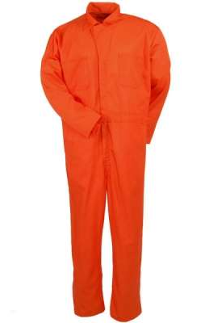
Suppose
To be identified with God’s people – required to wear
Orange Coveralls
What would you do?
Rather look like world?
Worth the sacrifice?
Make sure yours were orange?
2 Cor. 6:14-17

Slide 65
Sexually Attractive Dress
Simple Principles For Dress
Possible Your Clothes Could Be Sexually Attractive
Objections

Slide 66
Conclusion
Applies
to
Men
as well as
Women
Gen. 3:21
Applies
when:
Stand
Sit
Bend
Lean
Applies
to more
more than
length of
clothing:
Tight
Form Fitting
See Through

Slide 67
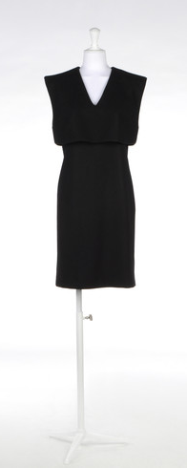
Could You Say That One Is Trying Not To Be “Sexually Attractive” When:
If an additional ½” of skin were shown “nakedness” is exposed?
If move, bend or sit – show “nakedness”?
If it were to be ¼” tighter – clearly mark out form?

