Slide 1
Are You Looking For The Church Described In The New Testament?

Slide 2
Who Makes Up The Church?
The word ekklesia (ἐκκλησία) refers to a gathering or assembly, i.e. those who have been called together.
In the context of the N.T. it is the people of God that have been called by the Lord through the gospel (2 Thess. 2:14).
The church is not part of the saved; the church is the saved (I Pet. 2:5, 9).

Slide 3
Christ Is Our Savior
The Church does not save me, Christ does! (John 14:6; Acts 4:12; Eph. 5:23)
The Church is the Saved:
The church is the effect of our salvation, “So then, those who had received His word were baptized; and that day there were added about three thousand souls…praising God and having favor with all the people. And the Lord was adding to their number day by day those who were being saved” (Acts 2:41, 47).
“For by one Spirit we were all baptized into one body…” (I Corinthians 12:13).

Slide 4
How Is The Term “Church” Used In The New Testament?
Universal Church:
All of the saved under the headship of Jesus Christ. This is an organism, rather than an organization. It refers to the relationship of God’s people through Christ.
“I also say to you that you are Peter, and upon this rock
I will build my church; and the gates of Hades will not overpower it”
(Matt. 16:18).

Slide 5
How Is The Term “Church” Used In The New Testament?
Universal Church:
All of the saved under the headship of Jesus Christ. This is an organism, rather than an organization. It refers to the relationship of God’s people through Christ.
“…And he put all things in subjection under his feet, and gave him as head over all things to the church, which is his body, the fullness of him who fills all in all”
(Ephesians 1:22-23).

Slide 6
How Is The Term “Church” Used In The New Testament?
Universal Church:
All of the saved under the headship of Jesus Christ. This is an organism, rather than an organization. It refers to the relationship of God’s people through Christ.
“There is one body and one Spirit, just as also you were called in one hope of your calling; one Lord, one faith, one baptism, one God and Father of all who is over all and through all and in all”
(Eph. 4:4-6).

Slide 7
How Is The Term “Church” Used In The New Testament?
Universal Church:
All of the saved under the headship of Jesus Christ. This is an organism, rather than an organization. It refers to the relationship of God’s people through Christ.
“He is before all things, and in him all things hold together. He is also head of the body, the church; and He is the beginning, the firstborn from the dead, so that He Himself will come to have first place in everything”
(Colossians 1:17-18).

Slide 8
How Is The Term “Church” Used In The New Testament?
Universal Church:
All of the saved under the headship of Jesus Christ. This is an organism, rather than an organization. It refers to the relationship of God’s people through Christ.
“But you have come to Mount Zion and to the city of the living God, the heavenly Jerusalem and to myriad of angels, to the general assembly and church of the firstborn who are enrolled in heaven, and to God, the Judge of all, and to the spirits of the righteous made perfect…”
(Hebrews 12:22, 23).

Slide 9
Are You Looking For
The New Testament Church?
Description
Passage
Jesus
Relationship
“the church”
(Acts 8:3, etc.)
The One Who Calls
The Called Out
“the church of God”
(Acts 20:28)
Paid The Price
Purchased of God
“the body of Christ”
(1 Cor. 12:27)
Headship
Members
“the kingdom of God”
(Rom. 14:17)
Kingship
Citizens
“the family of God”
(1 Tim. 3:15)
Son
Children
“the temple of God”
(1 Cor. 3:16)
High Priest
Serve / Worship
“the church of the firstborn”
(Heb. 12:23)
Heir
Fellow Heirs

Slide 10
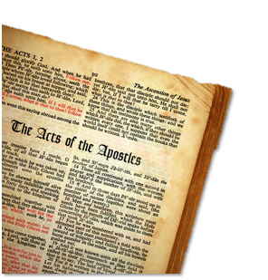
How Is The Term “Church” Used In The New Testament?
The Universal Church is composed of individuals, not denominations or even local churches tied together:
“Now you are Christ’s body and individually members of it”
(I Corinthians 12:27).

Slide 11
How Is The Term “Church” Used In The New Testament?
In relation to God’s calling: “saints” (1 Cor. 1:1-2)
In relation to the gospel: “believers” (1 Thess. 1:7)
In relation to Christ: “Christians” (Acts 11:26)
In relation to the Father: “children of God” (1 Jn. 3:1)
In relation to Christ’s teaching: “disciples” (Acts 6:7)
In relation to one another: “brethren” (1 Cor. 1:10)

Slide 12
How Is The Term “Church” Used In The New Testament?
The Local Church
Christians in a specific area, who work and worship together according to the Biblical pattern of organization
“The church of God which is at Corinth” (1 Cor. 1:2)
“The church of the Thessalonians in God”
(1 Thess. 1:1)
“The churches of Galatia”(1 Cor. 16:1)
“The churches of the saints” (1 Cor. 14:33)
“The churches of Christ” (Rom. 16:16)
“The churches” (Acts 8:3; 15:41, etc.)
“The Seven churches of Asia” (Rev 2; 3).

Slide 13
How Is The Term “Church” Used In The New Testament?
Function of Local Churches:
Christians who continue steadfastly in the apostles’ doctrine (Acts 2:42).
Believers who agree to join in fellowship in faithful service to Christ (Acts 2:44).
Worship in a common assembly (I Cor. 11:18).
Submit to spiritual shepherding and oversight (Acts 14:23; 20:28).

Slide 14
New Testament Pattern For The Organization of Local Churches
“Paul and Timothy, bond-servants of Christ Jesus, to all the saints in Christ Jesus who are in Philippi, including the overseers and deacons…” (Phil. 1:1).
“For this reason I left you in Crete that you would set in order what remains and appoint elders in every city as I directed you…” (Titus 1:5).
“When they had appointed elders for them in every church, having prayed with fasting they commended them to the Lord in whom they believed” (Acts 14:23).

Slide 15
New Testament Pattern For The Organization of Local Churches
The terms “elders,” “overseers,” “pastors,” “presbyters,” “bishops” and “shepherds” are various terms describing differing aspects of the work and function of the same office (Acts 14:23; 20:28; Eph. 4:11; I Timothy 3:1; 4:14; I Peter 5:1).
The Scriptures provide a description of the qualities which shepherds are to have, as well as the qualities deacons are to possess (I Timothy 3:1-13; Titus 1:5-9).
Ephesians 4:11 speaks of “evangelists, pastors and teachers…”

Slide 16
New Testament Pattern For The Organization of Local Churches
.
Local congregations were autonomous, self-ruling and independent:
“…Shepherd the flock of God among you…” (I Pet. 5:2a).
The revelation of Scripture indicates that the local church is sufficient to edify, evangelize and provide benevolent care for the needs of the saints (Eph. 4:12-16; Acts 2:44-47; 4:32-35; 11:27-30; 2 Corinthians 8-9).

Slide 17
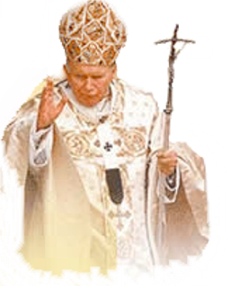
Organizational Changes
Step #5
Arch Bishops
588 – “Papa” John the Faster
Step #6
POPE –
Boniface III
606 AD
Step #4
Diocesan Bishop
Step #3
Metropolitan Bishops
Step #2
Elder – Bishop distinction
Step #1
Presiding elder
Elders
Elders
Elders
Elders
Elders
Elders
Elders
Elders
Notes:
I. Introduction
With this lesson the student of church history embarks upon a study of that long, dark process of apostasy which eventually culminated in the Roman Catholic Church. This apostasy unfolded very gradually.
II. The Rise of the Monarchical Episcopate
The first step which apostasy took in the church was in the corruption of its organization.
Presiding Elders – one elder had preeminence over the others -
Elder – Bishop distinction – The word bishop came to have reference to a different office – having greater authority -
Metropolitan Bishops – Bishop’s in larger cities oversaw rose to more preeminent status than did those in smaller locations
Diocesan Bishop – Churches within a particular region was grouped together in what came to be known as a diocese – One of the metropolitan bishops were chosen to oversee that diocese (all churches in that region)
Arch Bishops – (Alexandria, Jerusalem, Antioch, Constantinople, & Rome) – eventually – the Christian world was made up of five regions – the five men who oversaw these regions were known as Arch Bishops -
The Pope – (606 AD.) Boniface the 3rd – was the first recognized universal bishop – or pope.
John

Slide 18
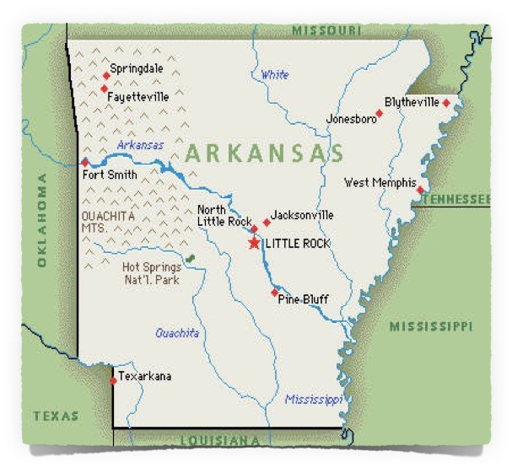
New Testament Pattern For The Organization of Local Churches
Bishops over a plurality of congregations
Elders
Elders
Elders
A Bishop over a plurality of congregations
Elders
Elders
Bishop

Slide 19
Unscriptural Forms of Organization
A single man over a single congregation
Elders
Pastor
Elders
A group over a plurality of congregations
Elders
Elders
Council

Slide 20
The Eternal Purpose of the NT Church
.
Realized at the right time in human history (Eph. 1:10-11).
Revelation of divine mystery (3:2-9).
Manifestation of God’s wisdom in the church (3:10-11).
Promise of God – First Pentecost after the resurrection of Jesus in Jerusalem (Isa. 2:2; Daniel 2:44-45; Matt. 3:2; Mark 9:1; Luke 24:46-49; Acts 1:6-8; 2:1-4; Col. 1:13; Heb. 12:28-29).

Slide 21
Entrance Into The NT Church
.
“So then, those who had received his word were baptized; and that day there were added to them about three thousand souls…And the Lord was adding to their number day by day those who were being saved”
(Acts 2:41, 47).

Slide 22
Entrance Into The NT Church
.
“For by one Spirit we were all baptized into one body, whether Jews or Greeks, whether slaves or free, and we were all made to drink of one Spirit”
(I Corinthians 12:13).

Slide 23
Entrance Into The NT Church
.
“For you are all sons of God through faith in Christ Jesus. For all of you who were baptized into Christ have clothed yourselves with Christ. There is neither Jew nor Greek, there is neither slave nor free man, there is neither male nor female; for you are all one in Christ Jesus”
(Gal. 3:26-28).

