Slide 2
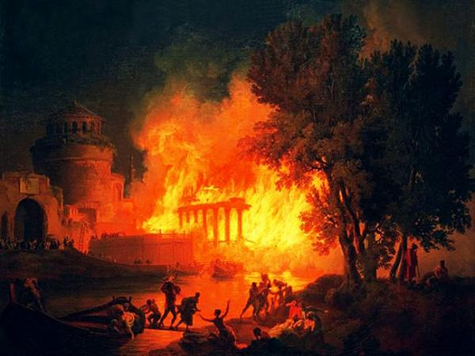
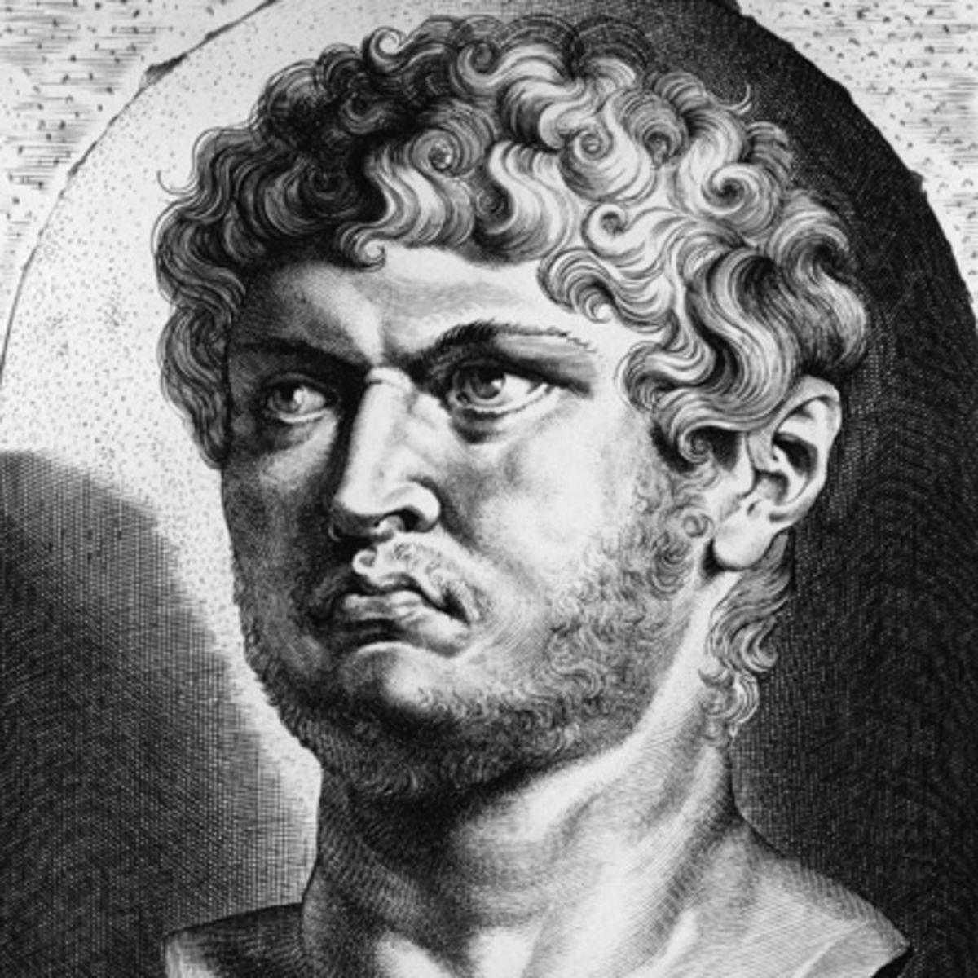

Slide 3
A Life Lived in the Perseverance of Faith
(1:6-9).

Slide 4
A Life Lived in Fulfilled Promise (1:10-12).

Slide 5
A Life Lived in the Holiness of Christ
(1:13-17).

Slide 6
A Life Lived in the Precious Redemption of the Lord
(1:18-22).

Slide 7
A Life Lived in the Fervent Love of the Brethren
(1:22).

Slide 8
A Life Lived in the Enduring
Word of God
(1:23-25).

Slide 10
The Hope of the Resurrection Life
Resurrection Living Through
the New Covenant:
“Chosen according to the foreknowledge of God the Father, by the sanctifying work of the Spirit, to obey Jesus Christ and be sprinkled with His blood…”

Slide 11
The Hope of the Resurrection Life
The Living Hope of Resurrection Living:
“ Blessed be the God and Father of our Lord Jesus Christ, who according to His great mercy has caused us to be born again to a living hope through the resurrection of Jesus Christ from the dead” (1:3).

Slide 12
The Hope of the Resurrection Life
The Heavenly Inheritance
of Resurrection Living:
“ …To obtain an inheritance which is imperishable and undefiled and will not fade away, reserved in heaven for you…” (1:4).

Slide 13
The Hope of the Resurrection Life
God’s Protective Power Over
Resurrection Living:
“ …Who are protected by the power of God through faith for a salvation ready to be revealed in the last time” (1:4).

