Slide 2
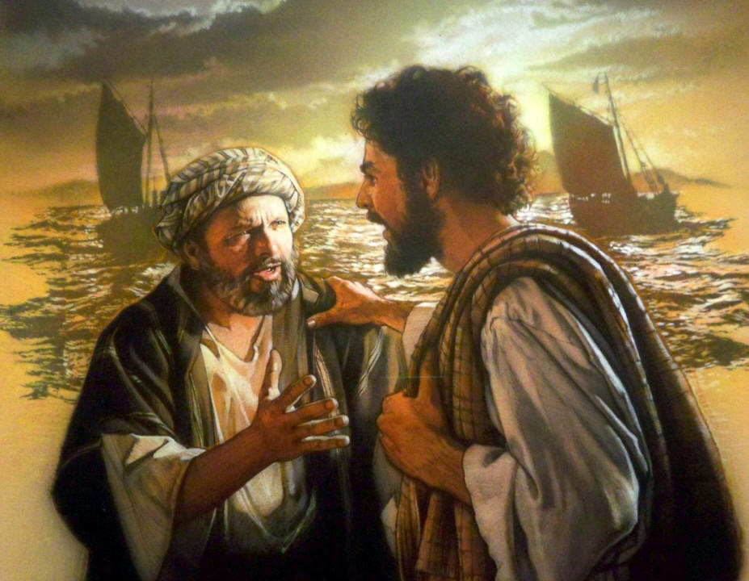
Renewal of Purpose
(21:1-11)
Peter asks his fellow disciples, “Anyone want to go fishing with me?” (21:3) What a perplexing thing to do after chapter 20 – the revelation of the resurrected Christ.
Why did they want to go fishing?

Slide 3
Renewal of Purpose
(21:1-11)
The historical narrative of Jesus calling His disciples some three years prior to this event are about to be replayed.
As if Jesus is reconstructing their original calling in order to say, “It is time to renew your purpose – there is still work to do and the Kingdom of God must drive you beyond your doubts into faith in the Lord!”

Slide 4
Renewal of Purpose
(21:1-11)
The event of Luke 5:1-11 served as confirmation of Jesus as Messiah, recognition of their own sinfulness and trust in Christ to forsake all and follow Him.
Jesus is rebuilding Peter by retracing his journey with His Savior.

Slide 5
Restoration of Relationship
(21:12-14)
Remember in chapter 13 Peter had loudly and emphatically declared that he would die for Jesus and he would never deny Him. Yet in chapter 18 Jesus watched as he did deny him, just as the Lord had predicted.
This was also a symbolic indication that fellowship and communion with Christ had been restored

Slide 6
Reclaiming of Mission/Work
(21:15-23)
Only through facing the terrible night of denial could Peter move forward in the purpose of Christ.
Notice that Jesus follows up each affirmation of love on the part of Peter with an invitation to join in the work of Christ!
Consider the faith Peter came to have in his writings!

