Slide 2
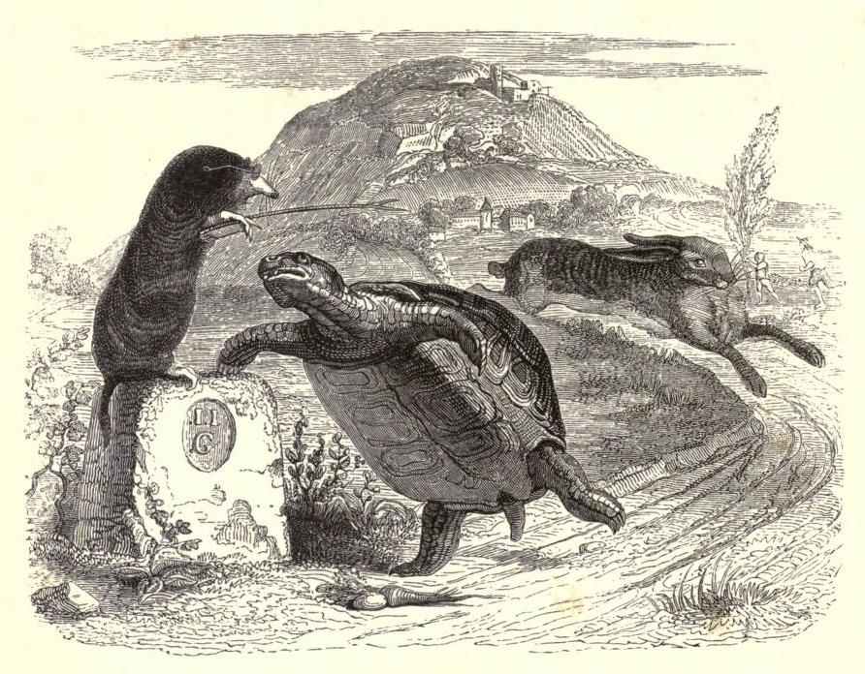
Preaching Fables
Notes:
Preaching Fables
Introduction
Just like today, the first century church was confronted with various dangers.
These threats against the church in the first century are often easily related to those of which we face today, and must be dealt with accordingly.
We must “contend earnestly for the faith which was once for all delivered to the saints” (Jude 3) knowing that →
“Jesus Christ is the same yesterday, today, and forever” (Hebrews 13:8) therefore the applications remain relevant.
Culture changes, and people with it, but Christ’s doctrine endures, being unchangeable.
The devil is very good at what he does. His tactics range, but he is perhaps most notorious for deception.
“Now the serpent was more cunning than any” (Genesis 3:1).
“that serpent of old, called the Devil and Satan, who deceives the whole world” (Revelation 12:9).
One difficulty dealt with in the first century was the teaching, and dwelling upon, fables.
Fables found 5 times in NT (cf. 1 Timothy 1:4; 4:7; 2 Timothy 4:4; Titus 1:14; 2 Peter 1:16).
A consideration of this topic is extremely beneficial, and is quite telling.
It would be prudent for us to make application today.
What are fables?

Slide 3
What Are Fables?
mythos; (through the idea of tuition); a tale, i.e. fiction (“myth”): — fable. (Strong)
A story, narrative, fable, fiction; The word is used of gnostic errors and of Jewish and profane fables and genealogies…[and] of fiction. (Vine)
Intended for good, involving a higher teaching or moral.
Notes:
What are fables?
Definition
g3454. μῦθος mythos; perhaps from the same as 3453 (through the idea of tuition); a tale, i.e. fiction (“myth”): — fable. (Strong)
a story, narrative, fable, fiction; The word is used of Gnostic errors and of Jewish and profane fables and genealogies…[and] of fiction. (Vine)
In scripture (NT = 5 times).
The aim in telling fables or discussing fables was educational. People sought to teach, and be taught, with these narratives. (Spiritual intentions)
Talmud – compilation of Rabbinical traditions and fables. (Traditions of the elders – in the Talmud.)
“If the Bible is the cornerstone of Judaism, then the Talmud is the central pillar, soaring up from the foundations and supporting the entire spiritual and intellectual edifice. In many ways the Talmud is the most important book in Jewish culture, the backbone of creativity and of national life. No other work has had a comparable influence on the theory and practice of Jewish life, shaping spiritual content and serving as a guide to conduct.” (Rabbi Steinsaltz, The Essential Talmud, pg. 3)
It often involved genealogies. They would insert fictitious names into the genealogies and fabricated captivating stories.
These tales were intended for good, involving a higher teaching or moral.
It was not necessarily the case that these stories promoted immoral practices which contradicted the moral doctrine of Christ. (Although it is certainly true that some likely did contradict Christ’s teaching.)
However, these stories were mere fabrications. Human inventions. False stories.
“One of the most successful arts of the adversary of souls has been to mingle fable with truth; and when he cannot overthrow the truth by direct opposition, to neutralize it by mingling with it much that is false and frivolous.” (Albert Barnes’ Notes on the Bible, 1 Timothy 1:4)
Fables and the Gospel (not a good connection).

Slide 4
What Are Fables?
Fables And The Gospel
2 Timothy 4:4; Titus 1:14; 1 Timothy 1:4
Difference From False Doctrine
1 Timothy 1:18-20; 4:1-6; 1 John 4:1-3; Matthew 7:15-20; 1 Timothy 1:4; 4:7; 2 Timothy 2:16
Cunningly Devised
2 Peter 1:16-21
Notes:
Fables and the Gospel (not a good connection).
The truth took a back seat to these fables often times (cf. 2 Timothy 4:4).
Men turned from the truth to fables (cf. Titus 1:14).
They were mistaken to cause godly edification (cf. 1 Timothy 1:4).
Difference from false doctrine (still no better than false doctrine).
Timothy was to wage war (cf. 1 Timothy 1:18-20).
This included instructing brethren about false doctrine (cf. 1 Timothy 4:1-6).
In doing so, Timothy would be contending for the faith (cf. Jude 3).
This logically included a testing and refutation of a doctrine which was a perversion of the gospel (cf. 1 John 4:1-3; Matthew 7:15-20 – notice a comparison to a standard. False doctrine is a perversion/contradiction of the one standard, thus investigation of such is necessary to determine the truth.)
With fables, Timothy was simply told to reject them or not give heed to them – 1 Timothy 1:4; 4:7
False doctrine takes a truth, and twists it to contradiction. (Thus, truth is used to refute it.)
A fable can teach a high moral principle which can certainly be true, but the fable itself is a fabrication. (Thus, the instruction to simply reject it.)
Timothy is told to avoid these babblings (cf. 2 Timothy 2:16).
Shun – to stand all around; to be a bystander.
“which cause disputes rather than godly edification” (1 Timothy 1:4).
Men would quarrel about the fabricated stories.
To dispute with them would be foolish, for it implies they have something, when in reality it is make believe.
The instruction: shun them.
Timothy and Titus were instructed to confront false doctrine, using the truth to combat it, and avoid fables altogether. (Obviously there is a need to emphasize why fables are dangerous, and warn against them, but there is no detailed refutation of a specific fable.)
It would be foolish and unprofitable to argue against a made up story.
“reject profane and old wives fables” (1 Timothy 4:7) – reject – to beg off, i.e. deprecate, decline (Strong). (disdain to be bothered.)
Cunningly devised – to cleverly invent; have the appearance of wisdom and sophistication (cf. 2 Peter 1:16).
Peter wrote his 2nd epistle to warn of false teachers – the Gnostics.
They often used fables which were useless, but Peter and the rest of the apostles did not. →
The coming of Jesus is founded upon unalterable truths.
V. 16b-18 – eyewitness testimony.
V. 19-21 – Inspired scripture.
If Peter and the other apostles simply devised fables like the Gnostics, the message could not be trusted. It would then need to be rejected. (This is why the Gnostics likely accused them of following such fables.)(They needed to reject the Gnostic fables, and accept the apostolic doctrine, for the former was fraudulent, and the latter was inspired.)
An Unprofitable Substitute

Slide 5
An Unprofitable Substitute
Where is godliness found?
1 Timothy 1:3-4; 3:16
Where is the power of God to Salvation?
Romans 1:16; 1 Corinthians 1:18-25; 2:1-5, 11-12
Turned Aside To Fables (2 Timothy 4:4).
Notes:
An Unprofitable Substitute
Where is godliness found?
Some were seeking godliness in fables – 1 Timothy 1:3-4
There may be moral principles found in fables.
Yet, there is no profit to the one heeding the fable. No godliness is found in them. Why? →
Godliness – Godward piety. (Denotes that piety which, characterized by a Godward attitude, does that which is well-pleasing to Him.)
1 Timothy 3:16 – The truth is given the title, “The Mystery of Godliness.”
The effect the truth is intended to have is given as the title. (Metonymy)
I.e. revealed truth of living like God wants us to.
Godliness is only found in God’s message!
When one leads a moral life in response to a fable there is no profit! For, it is not in response to God’s word.
Same can be said of the fruit of the Spirit (cf. Galatians 5:22-23). (It isn’t fruit OF THE SPIRIT if it isn’t in response to the Spirit’s instruction.)
Where is the power of God to salvation?
Romans 1:16 – The means chosen by God by which salvation is accomplished is belief according to the gospel message!
1 Corinthians 1:18, 22-25 – The only message with the power to save is the seemingly foolish message of the cross.
1:17 – Christ sent Paul “to preach the gospel, not with wisdom of words, lest the cross of Christ be made of no effect.”
The Corinthians began to view the message of the cross as a philosophy, and Paul as the philosopher.
The message he preached was true, but they did not see it as coming from God – this could not save them →
2:1-5 – Faith in the wisdom of man (in any form, fables included) cannot save!
Where do we find God’s wisdom?
Not in any of man’s fabricated narratives. No matter what they advocate.
Only by revelation from God – 2:11-12
“by revelation [God] made known to [Paul] the mystery” (Ephesians 3:3).
“Turned aside to fables” (cf. 2 Timothy 4:1-5).
There is a doctrine which is sound.
Sound meaning healthy. It is doctrine which promotes spiritual health.
Many will turn away from that, to a doctrine which has no spiritual nutritional value. →
This is what is happening today even in the Lord’s church.
Instead of using copious scripture in sermons, while making application, and illustrations, stories are told.
Gospel preaching is by definition founded in the scriptures.
However, many want to simply tell stories, and use a single verse from the Bible as the illustration.
The story becomes the teacher.
Scripture becomes the filler.
God’s word DEMANDS an inward change – 2 Timothy 3:16-17; Romans 12:2
People cannot stomach such demands, and do not wish to hear, or think about, the consequences of negligence.
They then revert to stories they know not to be true, but nonetheless provide them comfort, although false.
You cannot turn to God and please Him without obeying a message from Him. Telling a story, whether a personal true story, or a fabricated narrative, cannot provide an individual eternal life.
Peter suggests the knowledge of Christ provides this power (cf. 2 Peter 1:2-4).

Slide 6
Preaching Fables
Notes:
Conclusion
Fable telling, listening, and requesting was prevalent in the first century.
The problem had to be dealt with, and participation in such was to be avoided.
We cannot be so naïve to think the type of storytelling in our day is any less foolish and destructive.
If we want to get to heaven we must preach, listen to, and obey the message that was devised there.

